Slide 1
Functional Dependencies-More Examples

Slide 2
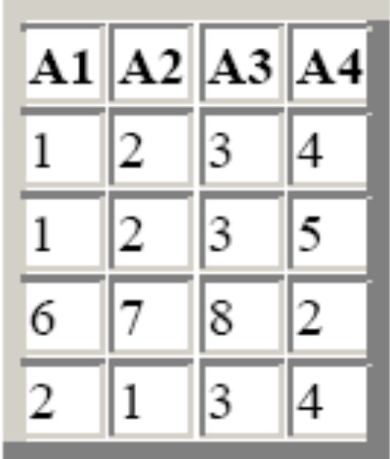
Exercise #1
Below is an instance of R(A1,A2,A3,A4). Choose the FD which may hold on R
A4->A1
A2A3->A4
A2A3->A1

Slide 3
Solution #1
1. A4->A1 ???
Incorrect: The 1st and 4th tuple violates it
2. A2A3->A4 ???
Incorrect: The1st and 2nd tuple violates it.
3. A2A3 -> A1 ???
Correct!

Slide 4
Exercise #2
Let R(ABCDEFGH) satisfy the following functional dependencies: {A->B, CH->A, B->E, BD->C, EG->H, DE->F}
Which of the following FD is also guaranteed to be satisfied by R?
1. BFG --> AE
2. ACG --> DH
3. CEG --> AB
Hint: Compute the closure of the LHS of each FD that you get as a choice.
If the RHS of the candidate FD is contained in the closure, then the candidate follows from the given FDs, otherwise not.

Slide 5
Solution #2
FDs: {A->B, CH->A, B->E, BD->C, EG->H, DE->F}
1. BFG --> AE ???
  Incorrect: BFG+ = BFGEH, which includes E, but not A
2. ACG --> DH ???
  Incorrect: ACG+ = ACGBE, which includes neither D nor H.
3. CEG --> AB ???
  Correct: CEG+ = CEGHAB, which contains AB

Slide 6
Question #3
Which of the following could be a key for R(A,B,C,D,E,F,G) with functional dependencies {AB->C, CD->E, EF->G, FG->E, DE->C, and BC->A}
1. BDF
2. ACDF
3. ABDFG
4. BDFG

Slide 7
Solution #3 - 1
{AB->C, CD->E, EF->G, FG->E, DE->C, and BC->A}
1. BDF ???
No. BDF⁺ = BDF
2. ACDF ???
No. ACDF⁺ = ACDFEG (The closure does not include B)
3. ABDFG ???
No. This choice is a superkey, but it has proper subsets that are also keys (e.g. BDFG⁺ = BDFGECA)

Slide 8
Solution #3 - 2
{AB->C, CD->E, EF->G, FG->E, DE->C, and BC->A}
4. BDFG ???
BDFG⁺ = ABCDEFG
Check if any subset of BDFG is a key:
  Since B, D, F never appear on the RHS of the FDs, they must form part of the key.
  BDF⁺ = BDF ← Not key
  So, BDFG is the minimal key, hence the candidate key

Slide 9
Finding Keys using FDs
Tricks for finding the key:
If an attribute never appears on the RHS of any FD, it must be part of the key
If an attribute never appears on the LHS of any FD, but appears on the RHS of any FD, it must not be part of any key

Slide 10
Exercise #5
Consider R = {A, B, C, D, E, F, G, H} with a set of FDs
F = {CD→A, EC→H, GHB→AB, C→D, EG→A,
H→B, BE→CD, EC→B}
Find all the candidate keys of R

Slide 11
Solution #5 - 1
F = {CD→A, EC→H, GHB→AB, C→D, EG→A, H→B, BE→CD, EC→B}
First, we notice that:
  EFG never appear on RHS of any FD. So, EFG must be part of ANY key of R
  A never appears on LHS of any FD, but appears on RHS of some FD. So, A is not part of ANY key of R
  We now see if EFG is itself a key…
  EFG+ = EFGA ≠ R; So, EFG alone is not key

Slide 12
Solution #5 - 2
Checking by adding single attribute with EFG (except A):
BEFG+ = ABCDEFGH = R; it’s a key [BE→CD, EG→A, EC→H]
CEFG+ = ABCDEFGH = R; it’s a key [EG→A, EC→H, H→B, BE→CD]
DEFG+ = ADEFG ≠ R; it’s not a key [EG→A]
EFGH+ = ABCDEFGH = R; it’s a key [EG→A, H→B, BE→CD]
If we add any further attribute(s), they will form the superkey. Therefore, we can stop here searching for candidate key(s).
Therefore, candidate keys are: {BEFG, CEFG, EFGH}

Slide 13
Exercise #6
Consider R = {A, B, C, D, E, F, G} with a set of FDs
F = {ABC→DE, AB→D, DE→ABCF, E→C}
Find all the candidate keys of R

Slide 14
Solution #6 - 1
F = {ABC→DE, AB→D, DE→ABCF, E→C}
First, we notice that:
  G never appears on RHS of any FD. So, G must be part of ANY key of R.
  F never appears on LHS of any FD, but appears on RHS of some FD. So, F is not part of ANY key of R
  G+ = G ≠ R So, G alone is not a key!

Slide 15
Solution #6 - 2
Now we try to find keys by adding more attributes (except F) to G
  Add LHS of FDs that have only one attribute (E in E→C):
  GE+ = GEC ≠ R
  Add LHS of FDs that have two attributes (AB in AB→D and DE in DE→ABCF):
  GAB+ = GABD
  GDE+ = ABCDEFG = R; [DE→ABCF] It’s a key!
  Add LHS of FDs that have three attributes (ABC in ABC→DE), but not taking super set of GDE:
  GABC+ = ABCDEFG = R; [ABC→DE, DE→ABCF] It’s a key!
  GABE+ = ABCDEFG = R; [AB→D, DE→ABCF] It’s a key!
  If we add any further attribute(s), they will form the superkey. Therefore, we can stop here.
  The candidate key(s) are {GDE, GABC, GABE}

Slide 16
Exercise #7
Consider R = {A, B, C, D, E} with a set of FDs F = {AB→DE, C→E, D→C, E→A}
And we wish to project those FDs onto relation S={A, B, C}
Give the FDs that hold in S
Hint:
We need to compute the closure of all the subsets of {A, B, C}, except the empty set and ABC.
Then, we ignore the FDs that are trivial and those that have D or E on the RHS

Slide 17
Solution #7
R = {A, B, C, D, E}
F = {AB→DE, C→E, D→C, E→A}
S={A, B, C}
A+ = A
B+ = B
C+ = CEA [C→E, E→A]
AB+ = ABDEC [AB→DE, D→C]
AC+ = ACE [C→E]
BC+ = BCEAD [C→E, E→A, AB→DE]
We ignore D and E.
So, the FDs that hold in S are:
{C→A, AB→C, BC→A}
(Note: BC→A can be ignored because it follows logically from C→A)

